Slide 1
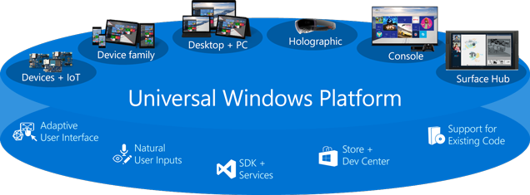
Universal Windows Platform (UWP)
TODO
Windows Applications for Mobile
Telerik Software Academy
http://academy.telerik.com

Slide 2
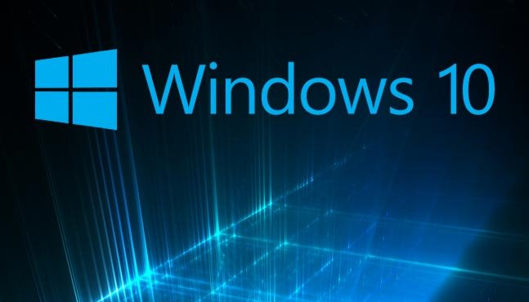

Table of Contents
What is new in Windows 10 for Users
What is new in Windows 10 for Developers

Slide 3
What is New in Windows 10 for Users?
Cortana – personal digital assistant
Windows Hello – automatic recognizes you
Microsoft Edge – brand new web browser
New Application Features – touch first, fast fluid, modern applications (including Office)
Xbox Live on Windows
More info:
https://youtube.com/watch?v=Wwc5jKc-EgE

Slide 4
What is New in Windows 10 for Developers?
One codebase for Universal Windows apps
Integration with the Windows Store
Touch-based interaction
Better multi-monitor support
Continuum for Windows Phone
Action Center
Notifications
Speech commands
Cortana

Slide 5
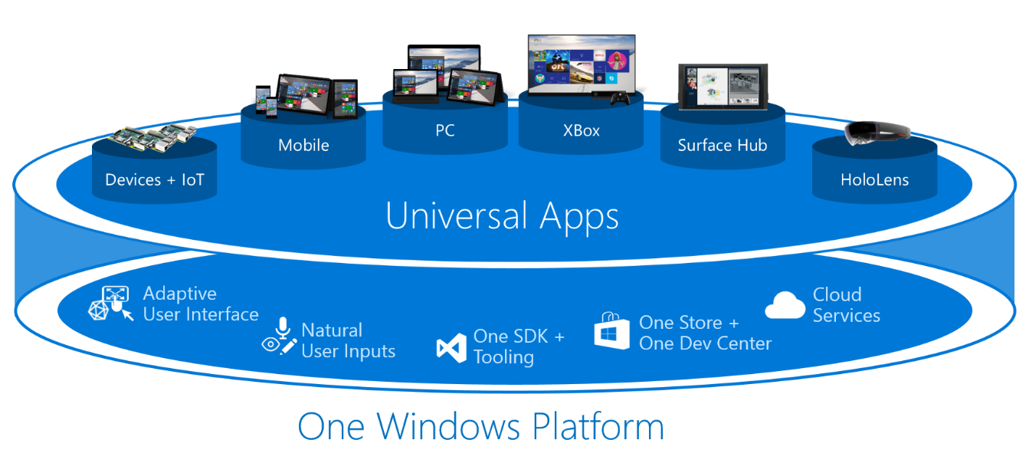
One Codebase
One codebase can run in Desktops, Xbox One, Tablets, Windows Phones, HoloLens and Embedded Devices (Raspberry Pi)

Slide 6
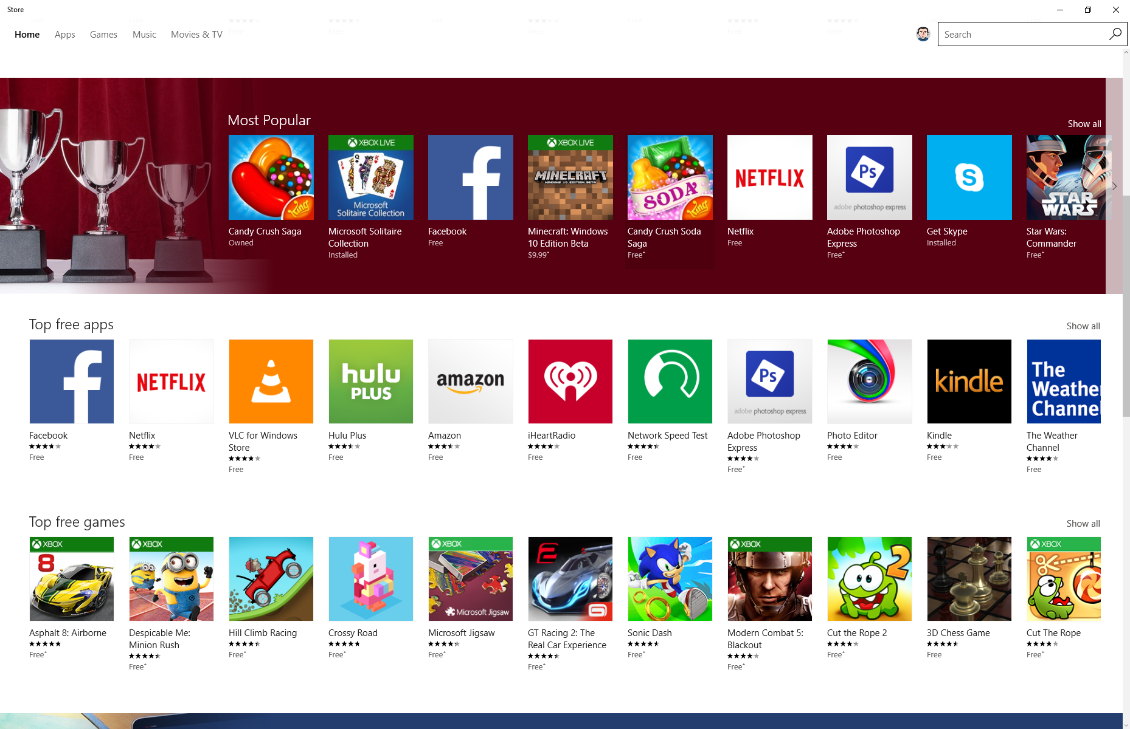
Windows 10 Store
Universal store across all devices where you can distribute and sell your app in 190 countries

Slide 7
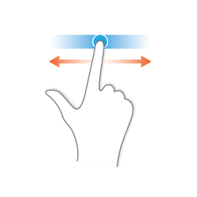
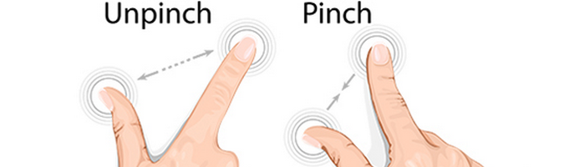
Touch Interaction
If the client machine has touch support – your application adjust itself to be touchable
The buttons and icons get bigger for better support of finger sizes
OS understands pinch, zoom and swipe gestures (your app just works)

Slide 8

Improved Multi-Monitor Support
Windows 8.1 and 10 provide support for multi-monitor without the need of 3rd party software
Per-monitor DPI scaling for different resolution
Attach low resolution tablet to bigger monitor
Increased usability with mixed screen sizes

Slide 9
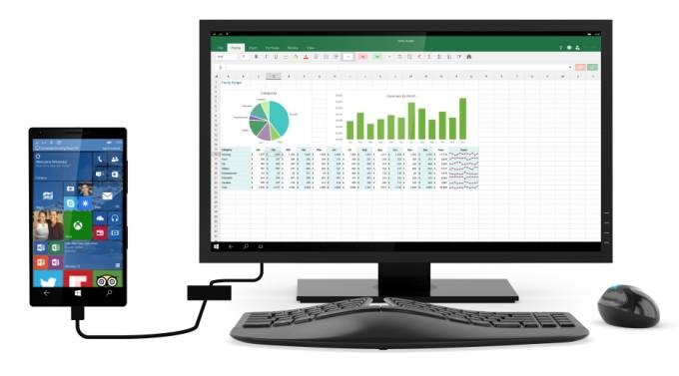
Continuum for Windows Phone
Windows 10 phones can also be PCs
Just add a display, and keyboard (and mouse?)
Win 10 includes a feature called Continuum that allows the same device to be used in different modes: youtube.com/watch?v=-oi1B9fjVs4

Slide 10
Universal Windows Platform (UWP)
Questions?

